Slide 1
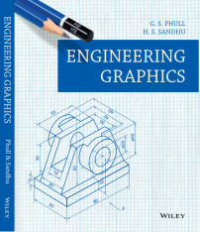
SCALES
DIMENSIONS OF LARGE OBJECTS MUST BE REDUCED TO ACCOMMODATE
ON STANDARD SIZE DRAWING SHEET.THIS REDUCTION CREATES A SCALE
OF THAT REDUCTION RATIO, WHICH IS GENERALLY A FRACTION..
SUCH A SCALE IS CALLED REDUCING SCALE
AND
THAT RATIO IS CALLED REPRESENTATIVE FACTOR.
FOR FULL SIZE SCALE
R.F.=1 OR ( 1:1 )
MEANS DRAWING
& OBJECT ARE OF
SAME SIZE.
Other RFs are described
as
1:10, 1:100,
1:1000, 1:1,00,000
SIMILARLY IN CASE OF TINY OBJECTS DIMENSIONS MUST BE INCREASED
FOR ABOVE PURPOSE. HENCE THIS SCALE IS CALLED ENLARGING SCALE.
HERE THE RATIO CALLED REPRESENTATIVE FACTOR IS MORE THAN UNITY.
USE FOLLOWING FORMULAS FOR THE CALCULATIONS IN THIS TOPIC.
DIMENSION OF DRAWING
A
REPRESENTATIVE FACTOR (R.F.) =
DIMENSION OF OBJECT
=
LENGTH OF DRAWING
ACTUAL LENGTH
=
AREA OF DRAWING
V
ACTUAL AREA
B
X
LENGTH OF SCALE = R.F. MAX. LENGTH TO BE MEASURED.
ENGINEERING GRAPHICS By Phull & Sandhu

Slide 2
BE FRIENDLY WITH THESE UNITS.
1 KILOMETRE
1 HECTOMETRE
1 DECAMETRE
1 METRE
1 DECIMETRE
1 CENTIMETRE
= 10 HECTOMETRES
= 10 DECAMETRES
= 10 METRES
= 10 DECIMETRES
= 10 CENTIMETRES
= 10 MILIMETRES
TYPES OF SCALES:
PLAIN SCALES ( FOR DIMENSIONS UP TO SINGLE DECIMAL)
DIAGONAL SCALES ( FOR DIMENSIONS UP TO TWO DECIMALS)
VERNIER SCALES ( FOR DIMENSIONS UP TO TWO DECIMALS)
COMPARATIVE SCALES ( FOR COMPARING TWO DIFFERENT UNITS)
SCALE OF CORDS ( FOR MEASURING/CONSTRUCTING ANGLES)
ENGINEERING GRAPHICS By Phull & Sandhu

Slide 3
PLAIN SCALE:-
This type of scale represents two units or a unit and it’s sub-division.
PROBLEM NO.1:- Draw a scale 1 cm = 1m to read decimeters, to measure maximum distance of 6 m.
Show on it a distance of 4 m and 6 dm.
CONSTRUCTION:-
a) Calculate R.F.=
R.F.= 1cm/ 1m = 1/100
Length of scale = R.F. X max. distance
= 1/100 X 600 cm
= 6 cms
b) Draw a line 6 cm long and divide it in 6 equal parts. Each part will represent larger division unit.
c) Sub divide the first part which will represent second unit or fraction of first unit.
d) Place ( 0 ) at the end of first unit. Number the units on right side of Zero and subdivisions
on left-hand side of Zero. Take height of scale 5 to 10 mm for getting a look of scale.
e) After construction of scale mention it’s RF and name of scale as shown.
f) Show the distance 4 m 6 dm on it as shown.
DIMENSION OF DRAWING
DIMENSION OF OBJECT
PLAIN SCALE
4 M 6 DM
10
0
1
2
3
4
5
METERS
DECIMETERS
R.F. = 1/100
PLANE SCALE SHOWING METERS AND DECIMETERS.
ENGINEERING GRAPHICS By Phull & Sandhu

Slide 4
PROBLEM NO.2:- In a map a 36 km distance is shown by a line 45 cms long. Calculate the R.F. and construct
a plain scale to read kilometers and hectometers, for max. 12 km. Show a distance of 8.3 km on it.
CONSTRUCTION:-
a) Calculate R.F.
R.F.= 45 cm/ 36 km = 45/ 36 . 1000 . 100 = 1/ 80,000
Length of scale = R.F. max. distance
= 1/ 80000 12 km
= 15 cm
b) Draw a line 15 cm long and divide it in 12 equal parts. Each part will represent larger division unit.
c) Sub divide the first part which will represent second unit or fraction of first unit.
d) Place ( 0 ) at the end of first unit. Number the units on right side of Zero and subdivisions
on left-hand side of Zero. Take height of scale 5 to 10 mm for getting a look of scale.
e) After construction of scale mention it’s RF and name of scale as shown.
f) Show the distance 8.3 km on it as shown.
PLAIN SCALE
8KM 3HM
10
5
0
1
2
3
4
5
6
7
8
9
10
11
KILOMETERS
HECTOMETERS
R.F. = 1/80,000
PLANE SCALE SHOWING KILOMETERS AND HECTOMETERS
ENGINEERING GRAPHICS By Phull & Sandhu

Slide 5
PROBLEM NO.3:- The distance between two stations is 210 km. A passenger train covers this distance
in 7 hours. Construct a plain scale to measure time up to a single minute. RF is 1/200,000 Indicate the distance
traveled by train in 29 minutes.
CONSTRUCTION:-
a) 210 km in 7 hours. Means speed of the train is 30 km per hour ( 60 minutes)
Length of scale = R.F. max. distance per hour
= 1/ 2,00,000 30km
= 15 cm
b) 15 cm length will represent 30 km and 1 hour i.e. 60 minutes.
Draw a line 15 cm long and divide it in 6 equal parts. Each part will represent 5 km and 10 minutes.
c) Sub divide the first part in 10 equal parts,which will represent second unit or fraction of first unit.
Each smaller part will represent distance traveled in one minute.
d) Place ( 0 ) at the end of first unit. Number the units on right side of Zero and subdivisions
on left-hand side of Zero. Take height of scale 5 to 10 mm for getting a proper look of scale.
e) Show km on upper side and time in minutes on lower side of the scale as shown.
After construction of scale mention it’s RF and name of scale as shown.
f) Show the distance traveled in 29 minutes, which is 14.5 km, on it as shown.
PLAIN SCALE
DISTANCE TRAVELED IN 29 MINUTES.
14.5 KM
KM
5 2.5
0
5
10
15
20
25
KM
MIN
10
0
10
20
30
40
50
MINUTES
R.F. = 1/100
PLANE SCALE SHOWING METERS AND DECIMETERS.
ENGINEERING GRAPHICS By Phull & Sandhu

Slide 6
We have seen that the plain scales give only two dimensions, such as a unit and it’s subunit or it’s fraction.
DIAGONAL
SCALE
The diagonal scales give us three successive dimensions
that is a unit, a subunit and a subdivision of a subunit.
The principle of construction of a diagonal scale is as follows.
Let the XY in figure be a subunit.
From Y draw a perpendicular YZ to a suitable height.
Join XZ. Divide YZ in to 10 equal parts.
Draw parallel lines to XY from all these divisions
and number them as shown.
From geometry we know that similar triangles have
their like sides proportional.
Consider two similar triangles XYZ and 7’ 7Z,
we have 7Z / YZ = 7’7 / XY (each part being one unit)
Means 7’ 7 = 7 / 10. x X Y = 0.7 XY
:.
Similarly
1’ – 1 = 0.1 XY
2’ – 2 = 0.2 XY
Thus, it is very clear that, the sides of small triangles,
which are parallel to divided lines, become progressively
shorter in length by 0.1 XY.
X
Y
10’
10
9’
9
8’
8
7’
7
6’
6
5’
5
4’
4
3’
3
2’
2
1’
1
Z
ENGINEERING GRAPHICS By Phull & Sandhu

Slide 7
PROBLEM NO. 4 : The distance between Delhi and Agra is 200 km.
In a railway map it is represented by a line 5 cm long. Find it’s R.F.
Draw a diagonal scale to show single km. And maximum 600 km.
Indicate on it following distances. 1) 222 km 2) 336 km 3) 459 km 4) 569 km
DIAGONAL
SCALE
SOLUTION STEPS: RF = 5 cm / 200 km = 1 / 40, 00, 000
Length of scale = 1 / 40, 00, 000 X 600 X 10⁵ = 15 cm
Draw a line 15 cm long. It will represent 600 km.Divide it in six equal parts.( each will represent 100 km.)
Divide first division in ten equal parts.Each will represent 10 km.Draw a line upward from left end and
mark 10 parts on it of any distance. Name those parts 0 to 10 as shown.Join 9th sub-division of horizontal scale
with 10th division of the vertical divisions. Then draw parallel lines to this line from remaining sub divisions and
complete diagonal scale.
569 km
459 km
336 km
222 km
10
9
8
7
6
5
4
3
2
1
0
KM
KM
100
50
0
100
200
300
400
500
KM
R.F. = 1 / 40,00,000
DIAGONAL SCALE SHOWING KILOMETERS.
ENGINEERING GRAPHICS By Phull & Sandhu

Slide 8
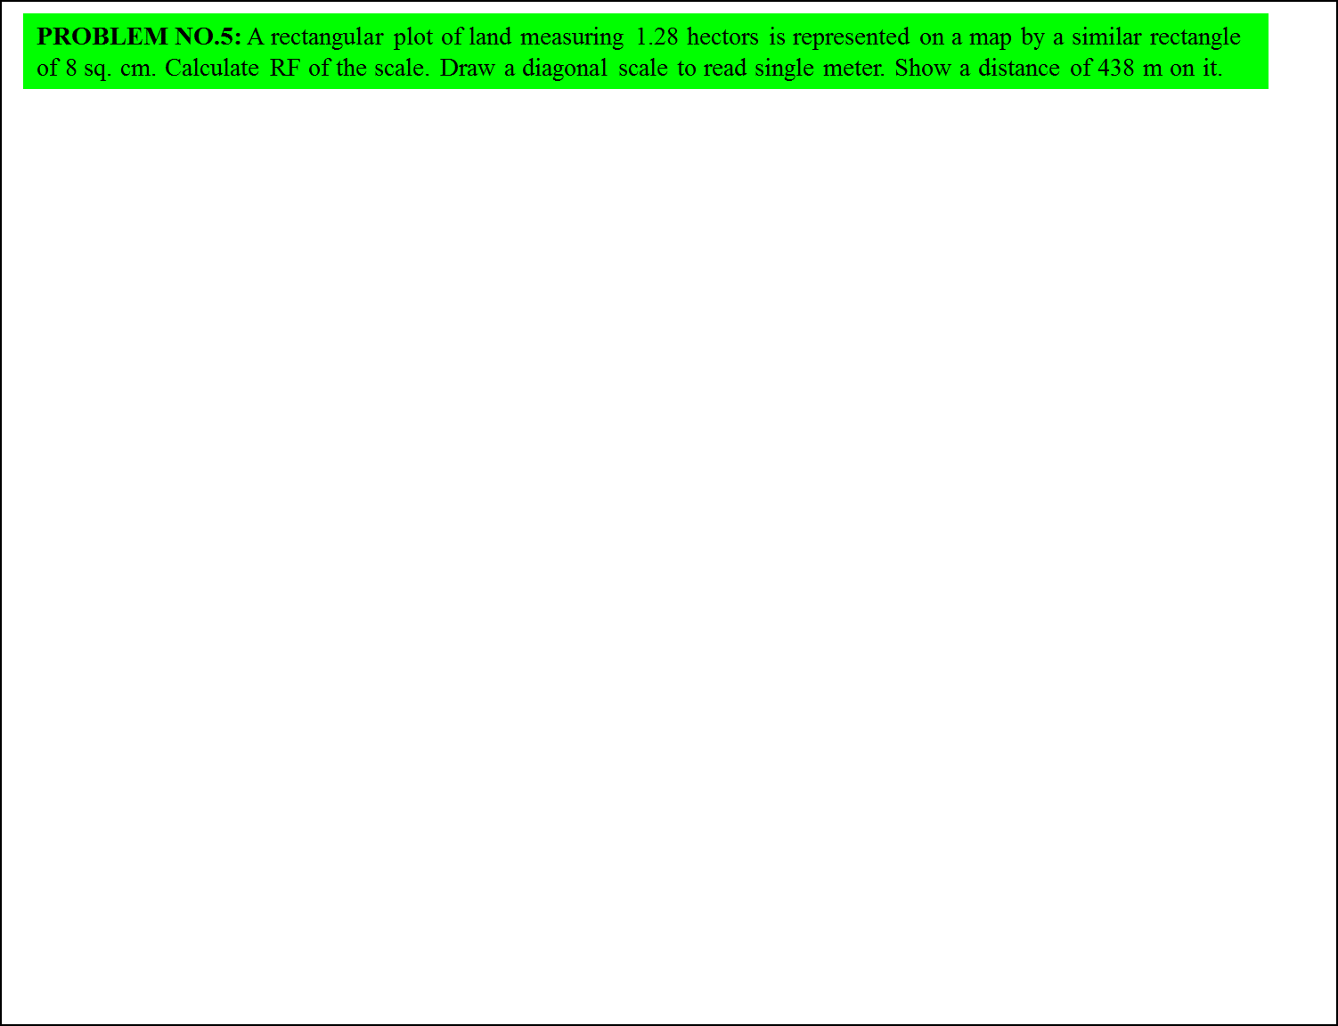
SOLUTION STEPS:
1 hector = 10, 000 sq. meters
1.28 hectors = 1.28 X 10, 000 sq. meters
= 1.28 X 10⁴ X 10⁴ sq. cm
8 sq. cm area on map represents
= 1.28 X 10⁴ X 10⁴ sq. cm on land
1 cm sq. on map represents
= 1.28 X 10 ⁴ X 10⁴ / 8 sq cm on land
1 cm on map represent
=
DIAGONAL
SCALE
Draw a line 15 cm long.
It will represent 600 m.Divide it in six equal parts.
( each will represent 100 m.)
Divide first division in ten equal parts.Each will
represent 10 m.
Draw a line upward from left end and
mark 10 parts on it of any distance.
Name those parts 0 to 10 as shown.Join 9th sub-division
of horizontal scale with 10th division of the vertical divisions.
Then draw parallel lines to this line from remaining sub divisions
and complete diagonal scale.
1.28 X 10 ⁴ X 10⁴ / 8
cm
= 4, 000 cm
1 cm on drawing represent 4, 000 cm, Means RF = 1 / 4000
Assuming length of scale 15 cm, it will represent 600 m.
438 meters
10
9
8
7
6
5
4
3
2
1
0
M
M
100
50
0
100
200
300
400
500
M
R.F. = 1 / 4000
DIAGONAL SCALE SHOWING METERS.
ENGINEERING GRAPHICS By Phull & Sandhu

Slide 9
PROBLEM NO.6:. Draw a diagonal scale of R.F. 1: 2.5, showing centimeters
and millimeters and long enough to measure up to 20 centimeters. Show the distance 13.4 cm on it
SOLUTION STEPS:
R.F. = 1 / 2.5
Length of scale = 1 / 2.5 X 20 cm.
= 8 cm.
1.Draw a line 8 cm long and divide it in to 4 equal parts.
(Each part will represent a length of 5 cm.)
2.Divide the first part into 5 equal divisions.
(Each will show 1 cm.)
3.At the left hand end of the line, draw a vertical line and
on it step-off 10 equal divisions of any length.
4.Complete the scale as explained in previous problems.
Show the distance 13.4 cm on it.
DIAGONAL
SCALE
13 .4 CM
10
9
8
7
6
5
4
3
2
1
0
MM
CM
5
4
3
2
1
0
5
10
15
CENTIMETRES
R.F. = 1 / 2.5
DIAGONAL SCALE SHOWING CENTIMETERS.
ENGINEERING GRAPHICS By Phull & Sandhu

